Slide 1
2023 Summer Internship Program Orientation
HR-ShihYun

Slide 2



WNC Regulation & Welfare
啓碁人才制度與福利
DIVERSITY多元, EQUITY平等& INCLUSION共融

Slide 3
Regulations
WNC Corporate Structure
Culture / Ten Beliefs / Ten Principles
Non-Disclosure Agreement

Slide 4
WNC Corporate Structure
Regulations
Dedicated BGs/BUs for each product line
Comprehensive function teams for BG/BU support
Chairman & CSO
Haydn Hsieh
President & CEO
Finance
Legal
Jeffrey Gau
Industrial Safety
Automotive, Module & Antenna
Business Group
(AMA BG)
Connected Home
Business Group
(CH BG)
Networking
Business Group
(NW BG)
Smart Vertical Services
Business Unit
(SVS BU)
Automotive tier-1 suppliers
Satellite broadcasting service providers
Consumer electronics brands
EV manufacturers
Telematics service providers
Telecom service providers
Satellite TV service providers
Smart energy system suppliers
Smart home service providers
Enterprise network equipment brand vendors
Cable TV operators
LEO satellite network service providers
Smart home service providers
Enterprise customers
System integrators
Global
Manufacturing
Global
Supply Chain
Management
Global Business Development
Quality
Assurance
Advanced Technology Development
MD & ID
Human
Resources
Administration
DMIS
Sustainable
Development &
Marketing
Notes:
WNC’s business operations comprise three BGs (Business Groups) and one BU (Business Unit). The three
BGs are Automotive, Module & Antenna, Connected Home, and Networking, while the one BU is Smart Vertical Services. The BGs and the BU are supported by function units responsible for manufacturing, global procurement, quality assurance, advanced technology R&D, and marketing.
Each BGU’s target customer segments:
AMA BG:
Automotive tier-1 suppliers
Satellite broadcasting service providers
Consumer electronics brands
EV manufacturers
Telematics service providers
P7
Automotive tier-1 suppliers (一階車廠供應商)
Satellite broadcasting service providers (衛星廣播服務商)
Consumer electronics brands (消費性電子品牌商)
EV manufacturers (EV車廠)
Telematics service providers(車載資通訊服務商)
Telecom service providers (電信服務商)
Satellite TV service providers (衛星電視服務商)
Smart energy system suppliers (智慧能源系統供應商)
Smart home service providers (智慧家庭服務商)
Enterprise network equipment brand vendors (企業網路設備品牌商)
Cable TV operators (有線電視營運商)
LEO satellite network service providers (低軌衛星網路服務商)
Smart home service providers (智慧家庭服務商)
Enterprise customers (企業客戶)
System integrators (系統整合商)

Slide 5

WNC Corporate Culture /Ten Beliefs/Ten Principles
Execute tasks effectively
Observe strict discipline . Distribute
rewards and punishments fairly
貫徹執行力
嚴守紀律,賞罰分明
十大信念
不與客戶的認知爭辯
勿言過其實，勿言不符實
不收賄 不行賄
不鄉愿 不官僚
未經授權不得揭露公司或工作上的機密
勿公器私用,以圖個人利益
Fundamentals
Advocacy
Become Top-level talent
in the industry
Strive for the highest quality
Be eager to learn and share
Reinforce cost consciousness
and create maximum profits.
Act with moral courage
and integrity
Customer Comes First
WNC
Core
Corporate
Values
Customer
Trust
Value Creation
Team Cohesion
勿本位主義,勿自私自利
不爭功諉過,不找藉口推諉
責任
不遲到,不早退,開會不遲到
不在公開場合發表不當言論，不應毀害公司的信譽
Promote Team Work
Shoulder Responsibilities
and take the initiative
Notes:
啟碁的核心價值從何而來？公司在上市之時，經營層為了讓同仁有一致的理念與核心價值得以依循，包含應做和不該做的，結集所有高階主管的意見而生。
從四大核心價值往外展開具體行為描述,公司標榜著十大信念/十大誡律. 這裡請舉例說明即可
創造價值：在企業中除了財務價值外，我們提供給客人的差異化價值(在系統整合與軟體價值上)，要能讓其進一步對其客戶產生價值。導入工業4.0也是一例，如：客戶可以不必親臨就透過軟體了解產品製造的過程。追求卓越品質是最重要的信念，這點做好，其他方面就容易達到好的結果。
以客為尊：不表示客人要求的我們一定要答應。了解客人的要求，營造一個雙贏的結果，是終極目標。
團隊合作：跨部門、跨BU都是我們在工作中常常面臨的合作。舉運動的例子，即使有再厲害的明星球員，如果沒有團隊的運作，單靠一個人的力量無法贏得勝利。
十大信念
抓頭抓尾，做到第一和第十以及第五項團隊合作，約可涵蓋中間的項目。
當我們公司越來越大，團隊合作變得越來越難。打造一個平台讓大家把工作上的訊息經驗知識分享是建立學習型組織，智慧公司/工廠，很重要的一件事。
十大誡律
第一項是首要項目。
公司平均每天會簽到3份NDA，包括台積電等大企業都非常重視，第二項務必切實遵守。
不與客戶的認知爭辨：爭辯”認知“徒勞無功，以價格為例，單點式的偏頗比較會造成錯誤的認知，但是我們可以藉由全面的說明溝通讓客戶了解我們能提供的價值，還是能以很好的價格取得生意

Slide 6
Non-Disclosure Agreement (NDA) Signing
Non-Compete Clause: Prohibition of Competing Activities during Employment
Respect for Intellectual Property Rights
Adherence to legal regulations regarding the company's and third parties' intellectual property, and avoidance of infringement.
Non-Disclosure Agreement Protecting company trade secrets and confidential information known in the course of employment."
Upholding Integrity Commitment: Adhering to ethical standards, prohibiting improper gains, and complying with laws and regulations.
Respect for
Intellectual
Property Rights
Non-Disclosure
Agreement
Upholding
Integrity
Commitment
Non-Compete
Clause
Notes:
參考腳本
這是各位早上報到時簽的一些合約,提醒各位在服務期間不做出違反法律相關問題
* 關於保護機密資訊的行為守則 : (依據2016/8/12 portal公告)
為妥善保護公司、客戶之機密資訊，請同仁留意並落實以下行為守則：
1. 任何公司或客戶提供的設計(design)、佈局(layout)、規格(spec)、原型(prototype)、圖像(image)、樣品(sample)，均視為機密資訊。
2. 討論專案內容，僅限與「職務上有知悉必要 (“need-to-know”)」之同仁。
3. 遵循公司相關資訊安全、系統權限、檔案管理等規範。不在任何公開場所、網路、論壇討論公司或客戶的產品、技術、專案。若未事前取得客戶的書面同意，不對客戶產品、材料、資訊拍照。且避免任何可能導致疑慮的行為。 僅限在指定區域審閱的產品或資料，不得攜出。
4. 若對任何機密資訊的判斷或保密措施有疑惑，請詢問主管、project leader 或法務智權中心。
5. 在職期間或離職後，保密義務均存續。違反保密義務，可能導致嚴重的法律風險與責任。

Slide 7
Whistleblower
WNC.Integrity <WNC.Integrity@wnc.com.tw>
Notes:
參考腳本
這是各位早上報到時簽的一些合約,提醒各位在服務期間不做出違反法律相關問題
* 關於保護機密資訊的行為守則 : (依據2016/8/12 portal公告)
為妥善保護公司、客戶之機密資訊，請同仁留意並落實以下行為守則：
1. 任何公司或客戶提供的設計(design)、佈局(layout)、規格(spec)、原型(prototype)、圖像(image)、樣品(sample)，均視為機密資訊。
2. 討論專案內容，僅限與「職務上有知悉必要 (“need-to-know”)」之同仁。
3. 遵循公司相關資訊安全、系統權限、檔案管理等規範。不在任何公開場所、網路、論壇討論公司或客戶的產品、技術、專案。若未事前取得客戶的書面同意，不對客戶產品、材料、資訊拍照。且避免任何可能導致疑慮的行為。 僅限在指定區域審閱的產品或資料，不得攜出。
4. 若對任何機密資訊的判斷或保密措施有疑惑，請詢問主管、project leader 或法務智權中心。
5. 在職期間或離職後，保密義務均存續。違反保密義務，可能導致嚴重的法律風險與責任。

Slide 8

Do not download or use illegal software
Admin
USB
All unauthorized software is considered illegal software
Authorized Software >Portal IT Service
MIS conducts regular audits to verify whether employees are using illegal software. If any violations are found, they will be reported to the supervisor for appropriate disciplinary action.“
Based on the decision of the ISMS management review committee, external websites that are deemed unrelated to official business will be blocked and prohibited from browsing through a blacklist approach. All other websites will remain accessible.。
"Photography or filming is strictly prohibited
Protect our Information security environment depend on each of you !
Notes:
2019/5/9調整外部網站瀏覽規定，由白名單改為黑名單管控
*2016/10/21增加進入廠區，禁止拍照或攝影(依據Haydn QBR) :
此部分可與機密資訊做前後呼應，請同仁應重視力行基本的保密職責，以及公司對客戶、產品、技術機密保密要求的重視程度，勿因一時不注意造成機密外洩，因小失大。

Slide 9
Work Rules - Working and Lunch Break Time"
Tips: Swipe the Access card Beside the security control room
Working Hour
AM 8:00-9:00
Lunch Break
PM 17:00-18:00
11:30-12:30 7F、8F
11:45-12:45 6F
12:00-13:00 3F
12:15-13:15 9F、10F
12:30-13:30 4F、5F
※ Check ours Daily working hour :Portal> Regulations >HR FAQ> Daily working time report
Notes:
參考腳本
首先和各位提到公司工作規則,其中上下班時間,每日總工時8小時(因應勞基法設立的彈性工時制).
中午用餐時段,公司是每季做樓層上調整,會在Portal公告.
進出廠部分,早上報到總務單位已帶大家實際觀摩,就不特別細說
用餐時間晚上16:50~19:20
2017/2/17編修: 加入S1用餐時間 12:00-13:00
2017/2/20增加說明(FYR Only):
2016年園丁會提案
同仁反應P棟車道人員行走有些危險
工安評估空間不足規畫人車分道，同時亦會影響會車
後經Haydn決議 :
停P棟停車位之同仁一律由中控進出，也取消可進出O棟梯廳進出的權限
去年底Ellen有統一發信告知停P棟的同仁此一消息
園丁會會議記錄亦有明載，不再另行公告
補充此資訊供講師知悉
講師無需特別在新人引導課程特別做說明
總務在同仁申請車位時，會再跟同仁做宣導
B1/B2主管專用(順序調整至中控室之後)
9:00到班，16:00後請假，應該請8:30-9:00和16:00-17:30

Slide 10
Ｗoops ! I Forgot to bring My Badge and Access Card?"
Go to the mail room register for a temporary access card
Register
Mail Room
Return
Temporary access card
※ Check ours Daily working hour :Portal> Regulations >HR FAQ> Daily working time report
Notes:
參考腳本
首先和各位提到公司工作規則,其中上下班時間,每日總工時8小時(因應勞基法設立的彈性工時制).
中午用餐時段,公司是每季做樓層上調整,會在Portal公告.
進出廠部分,早上報到總務單位已帶大家實際觀摩,就不特別細說
用餐時間晚上16:50~19:20
2017/2/17編修: 加入S1用餐時間 12:00-13:00
2017/2/20增加說明(FYR Only):
2016年園丁會提案
同仁反應P棟車道人員行走有些危險
工安評估空間不足規畫人車分道，同時亦會影響會車
後經Haydn決議 :
停P棟停車位之同仁一律由中控進出，也取消可進出O棟梯廳進出的權限
去年底Ellen有統一發信告知停P棟的同仁此一消息
園丁會會議記錄亦有明載，不再另行公告
補充此資訊供講師知悉
講師無需特別在新人引導課程特別做說明
總務在同仁申請車位時，會再跟同仁做宣導
B1/B2主管專用(順序調整至中控室之後)
9:00到班，16:00後請假，應該請8:30-9:00和16:00-17:30

Slide 11
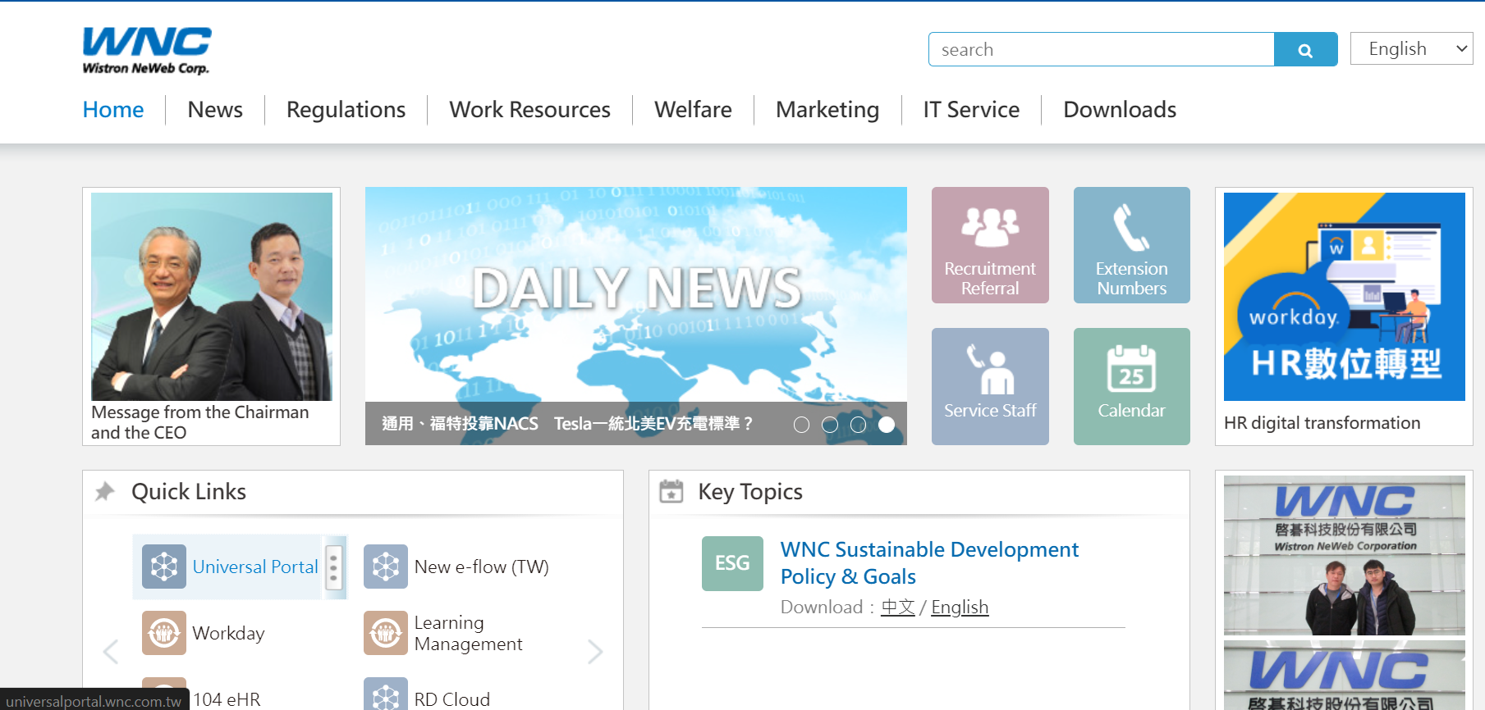
Start a Day in WNC
Step 1 :連結 http://portal.wnc.cpm.tw/
(Daily News / Service /Regulations）
Get Connected
Latest Extension Numbers
Calendar
Quick link
Meet up with
New Comer

Slide 12
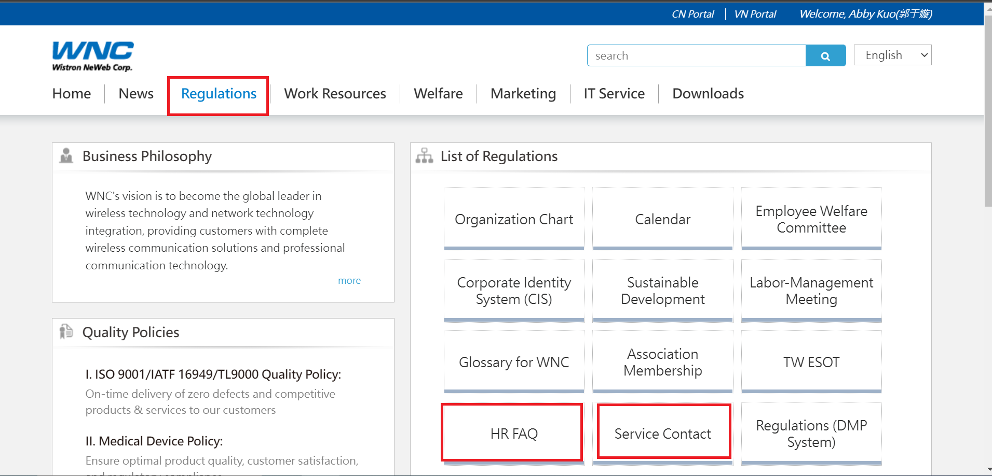
Portal Regulations
常見問題解答區
勞健保/團險/申請證明…等
Notes:
參考腳本
在介紹內部規章制度前,先跟各位新人介紹公司內部網頁-Portal, 含五個主要選單.後續會詳細介紹.
而內部規章制度對應位置在工作資訊如圖位置

Slide 13
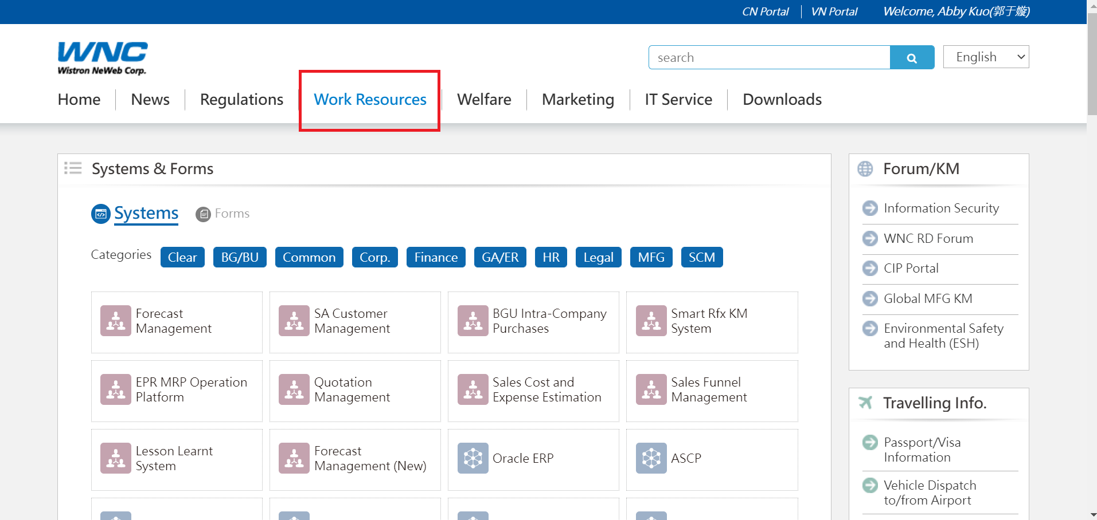
Portal Work Resources
System & form

Slide 14
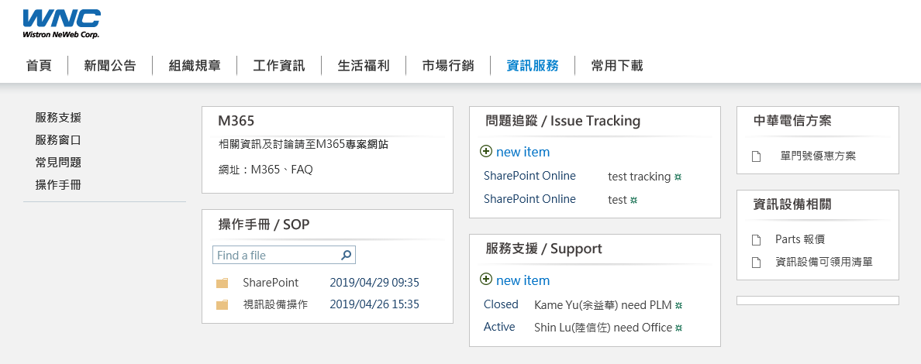
Portal IT Service
Helpdesk: WTQ- 1110&1119 ; S1- 1117
Various System
Service Windows

Slide 15
How do I apply for leave
Step (1) Let your Supervisor and Mentor Known by email or line
Step (2) Portal > Universal Portal Leave Application Form
Employees must obtain approval from their managers before submitting a leave application.
The minimum unit for taking leave is calculated in increments of ‘half hours'.
If there is a conflict between taking leave and scheduled activities, must notify HR
Type of leave | Leave period | Salary
Personal leave | Less than 14 days /per year | No pay for the day. | Lab meeting Personal /School affair
Sick leave | Non-hospitalization sick leave days for the year should not exceed 30 days. Hospitalization sick Leave not exceed 365 days. "The combined total of both types should not exceed 1 year."。 | (within30 days.) Half pay "exceed 30 days No pay | Ex: Get fever
Menstrual leave | 1 day each month, any excess days beyond 3 days throughout the year will be counted as sick leave." | Half Pay for the day | Ladies Only
Notes:
參考腳本
下方為參照勞基法定義的各種假別及對應薪資給付.
但這特別與大家強調的是不同身分差別,針對5職等以上是優於勞基法規定.請事/病假仍給薪
期待大家往上晉升,並續留啟碁

Slide 16

Demo Video
Step 1 :連結 http://portal.wnc.cpm.tw/
Inquiry Window for Leave and Overtime System-Related Questions ：
★ HQ : Wendia Chen /ext. 5545 ★ S1: Vicky Chang /ext. 5515 ★ S2: Mia Li / 5523
Notes:
參考腳本
以下請可與portal實際demo請假,並搭隨每一頁提醒說明
*2017/2/17編修 : 加入S1窗口

Slide 17
Environmental Safety and Health Promotion
Emergency Response
Traffic Safety
Occupational Safety
Notes:
參考腳本
關於廠區部分,與各位重點宣導安全觀念

Slide 18
Emergency Response and Reporting Hotline
1. Process：Reporting → Fire extinguishment → Evacuation
2. Reporting：On-Site Supervisor, Security Guard,
3. Fire extinguishment： It is important to be aware of the locations of fire extinguishing equipment, be able to use fire extinguishers, and effectively extinguish fires correctly.
4.Evacuation ： 4-1. Evacuate quickly along the designated escape route to the designated safe assembly point. 。
4-2. Do not Take elevators or freight elevators.
4-3. Proceed to the designated assembly point and wait for the headcount to be conducted.
Reporting Situations: Fire incidents, chemical spills, unusual odors, and personnel injuries that occur within the factory.
Reporting Situations: Injuries to personnel within the factory, commuting accidents.
Each department is equipped with a first aid kit for initial injury treatment.
For matters related to work-related injury assessment, please refer to the Portal.
EMEGENCY CALL (24hOURS)：
HQ&S1&S2-119
IN House nurse：
HQ&S1-5119 / S2-5570

Slide 19
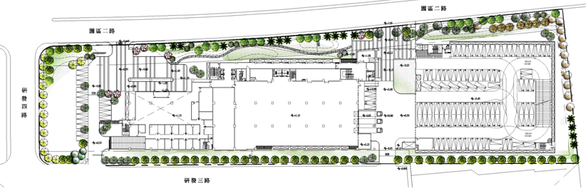
Commute route map
Security Guard
scooter
Please follow the instructions of the security guard."
Speed limit: 20 kilometers per hour.
Vehicle
Pedestrian.
園區二路Yuanqu 2nd Rd
矽
品
單車
/
機車
辦公棟
廠房棟
停車棟
研發三路
Yanfa 3rd Rd.
研發四路
UMC
/
Yanfa 4rd Rd.

Slide 20
Safety Information
AT Office：
Prior to sitting, it is recommended to use hands to touch or visually confirm the seating position. 。
AT GYM：
Correct approach: Refer to the operating instructions of the fitness equipment and carefully allocate one's physical capabilities when using it.
Walking ：
Correct approach: Pay attention to the condition of the floor while walking.
Notes:
參考腳本
為確保員工工作安全,這裡仍要和各位提醒在各種狀況下須注意地方,並提供醫護人員建議正確方式.

Slide 21
Office Safety Awareness
Electrical Safety
All extension cords must be labeled with the WNC certification in order to be used. (Inspection Window - Facility #5530)
Walking Safety
Take steady steps instead of running. 。
Walk attentively without using your phone.
Please slow down and walk carefully in areas with wet and slippery floors.
Fire Safety
Keep pathways clear and familiarize yourself with two or more safety exit locations.
Access to fire extinguishers and fire hydrants should not be blocked under any circumstances.
Fire Extinguisher Usage Mnemonic: Pull (Pin), Aim (Nozzle), Squeeze (Handle).
Safe Manual Handling
Minimize manual handling and utilize tools such as trolleys whenever possible.
Keep objects close to your body for more efficient and effortless handling.
Notes:
* 補充資訊 : (2017/3/2)
1.考量公共安全，且此為工作需求用品，公司願意承收器材費用，故請同仁勿從家裡帶延長線至公司使用。
2.延長線申請流程 :
搭配每個月的文具申請時機進行申請，總務同仁在採購延長線(統一安全規格)後，即會直接先請廠務檢查窗口double confirm，
完成確認後廠務檢查即會貼上WNC合格標籤，繼而再由總務同仁隨同當月申請文具，通知單位文具領取窗口統一領取。
3.日常安全稽核流程 :
工安單位會不定期進行廠區巡檢，如發現未貼WNC合格標籤之延長線即會要求同仁停用，並請同仁連絡檢查窗口_廠務#5530，
確認合格性。
4.如各位仍有廠規安全上的問題，可逕洽 : 工安/王景冠(#5557) ; 廠務/戴明誠(#5530) 。

Slide 22
Welfare
Payroll
Leaning Management System
Online library
Massage Service
SpaQall
Sports club

Slide 23
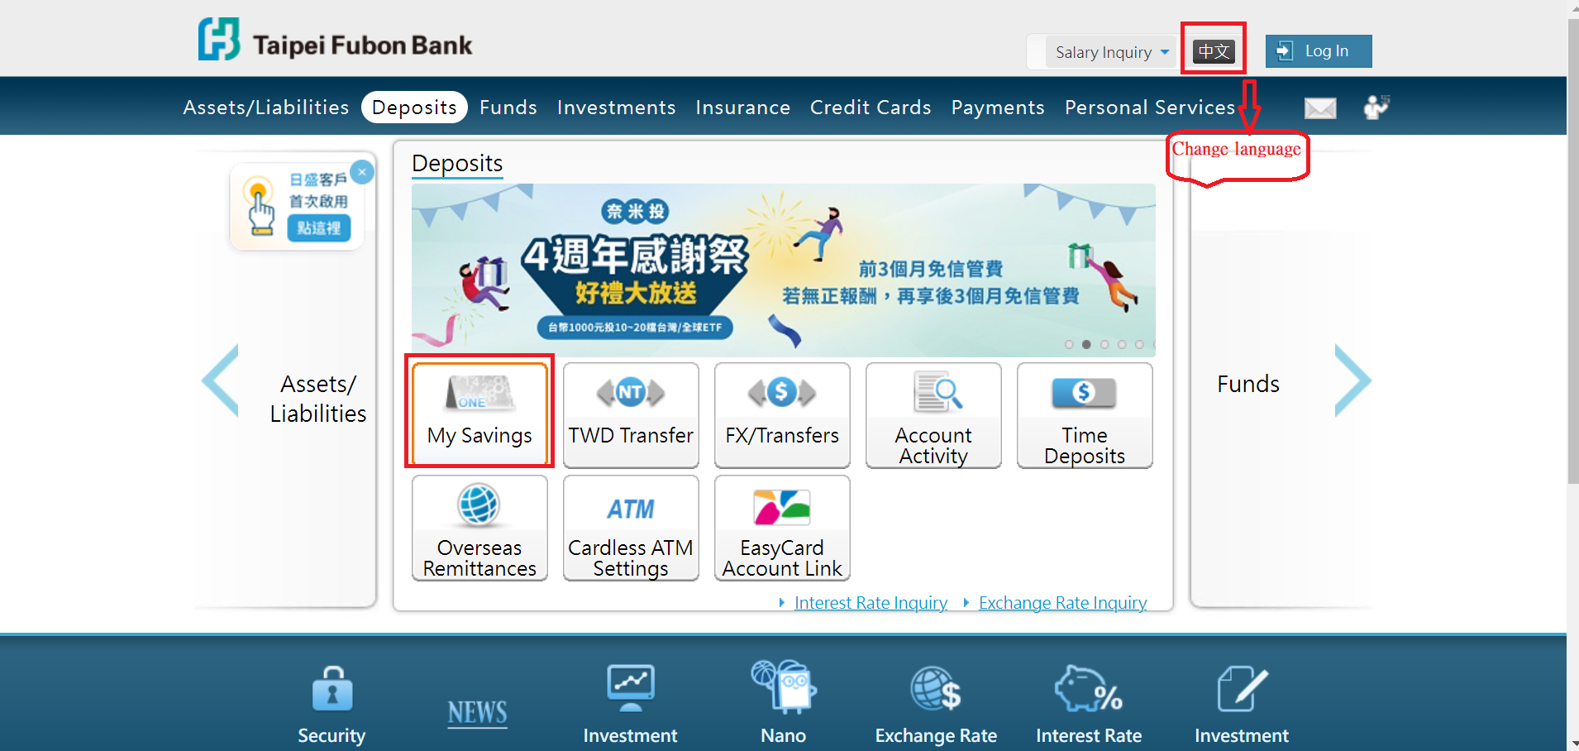
Payroll Reminder
Salary Disbursement on the 5th of Every Month (Salary for employees who start on the 26th of the current month or later will be included in the next month's disbursement)
TIPS:
After receiving your salary withdrawal card, please remember to change the password at the ATM.
The employee's salary account is with Taipei Fubon Bank. Starting from the payday, employees can enjoy fee-free interbank withdrawals or transfers. 。
https://ebank.taipeifubon.com.tw/B2C/common/Index.faces
Notes:
參考腳本
薪資發放時機提供各位了解,且薪資查詢現階段可透過台北富邦網頁查詢.
ATM在b1餐廳有兩台,每週一三中午會有駐廠人員
可加說團保部分-
員工本人-南山-含醫療險、意外險、壽險、癌症險
若要加眷屬-可選擇南山、中國人壽-含意外、醫療、癌症險

Slide 24
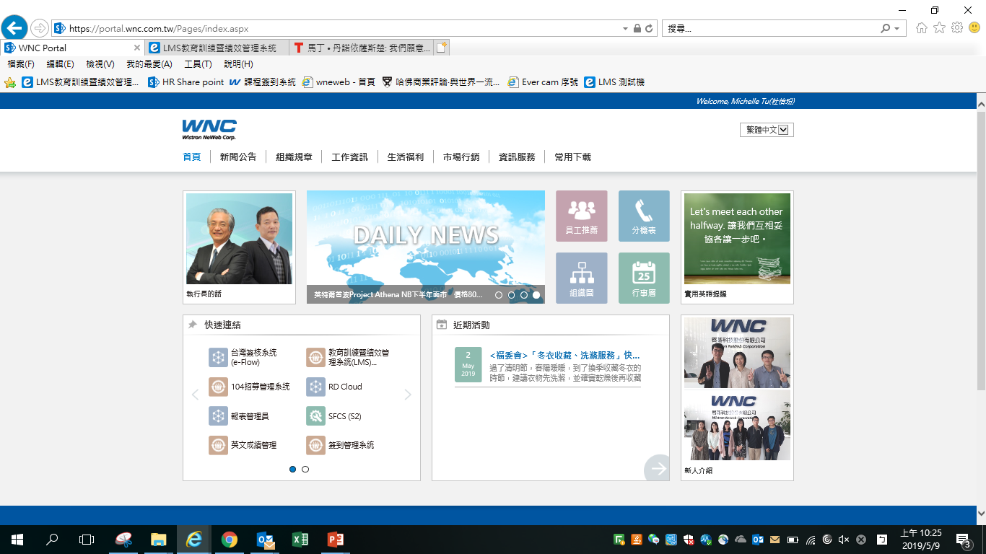
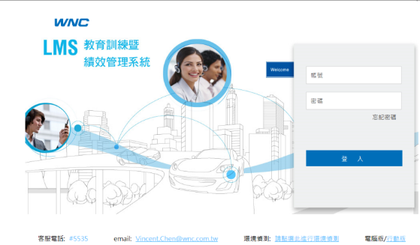
Growth Mindset
Learning Power
* Step: Log in LMS link:
http://lmsap.wneweb.com.tw/eHRD/SingleSignOnLogin.aspx
Account :Employee Number(23XXXXXX)
Password :keep in blank (at the first time )
* Step: 1 : portal →quick link → Learning Management System(LMS)
Notes:
參考腳本
接著我們透過系統與各位介紹.此系統為LMS(Learning Management System).這包含績效作業部分
登入方式 :
1.透過portal工作資訊 : 點選 “教育訓練/績效管理系統”，不用key帳密即會連結到LMS首頁
2.透過LMS網址登入 : KEY入帳號(工號),首次登入密碼不用key為”空白”

Slide 25
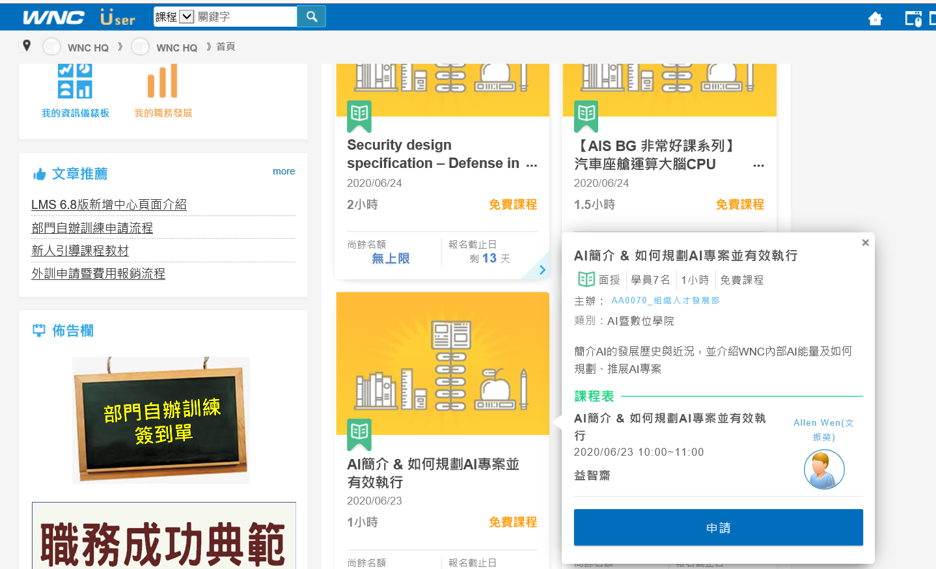
Internal Online Learning Resources
Login LMS→search engine『Courses of Interest to You』→Click Apply

Slide 26
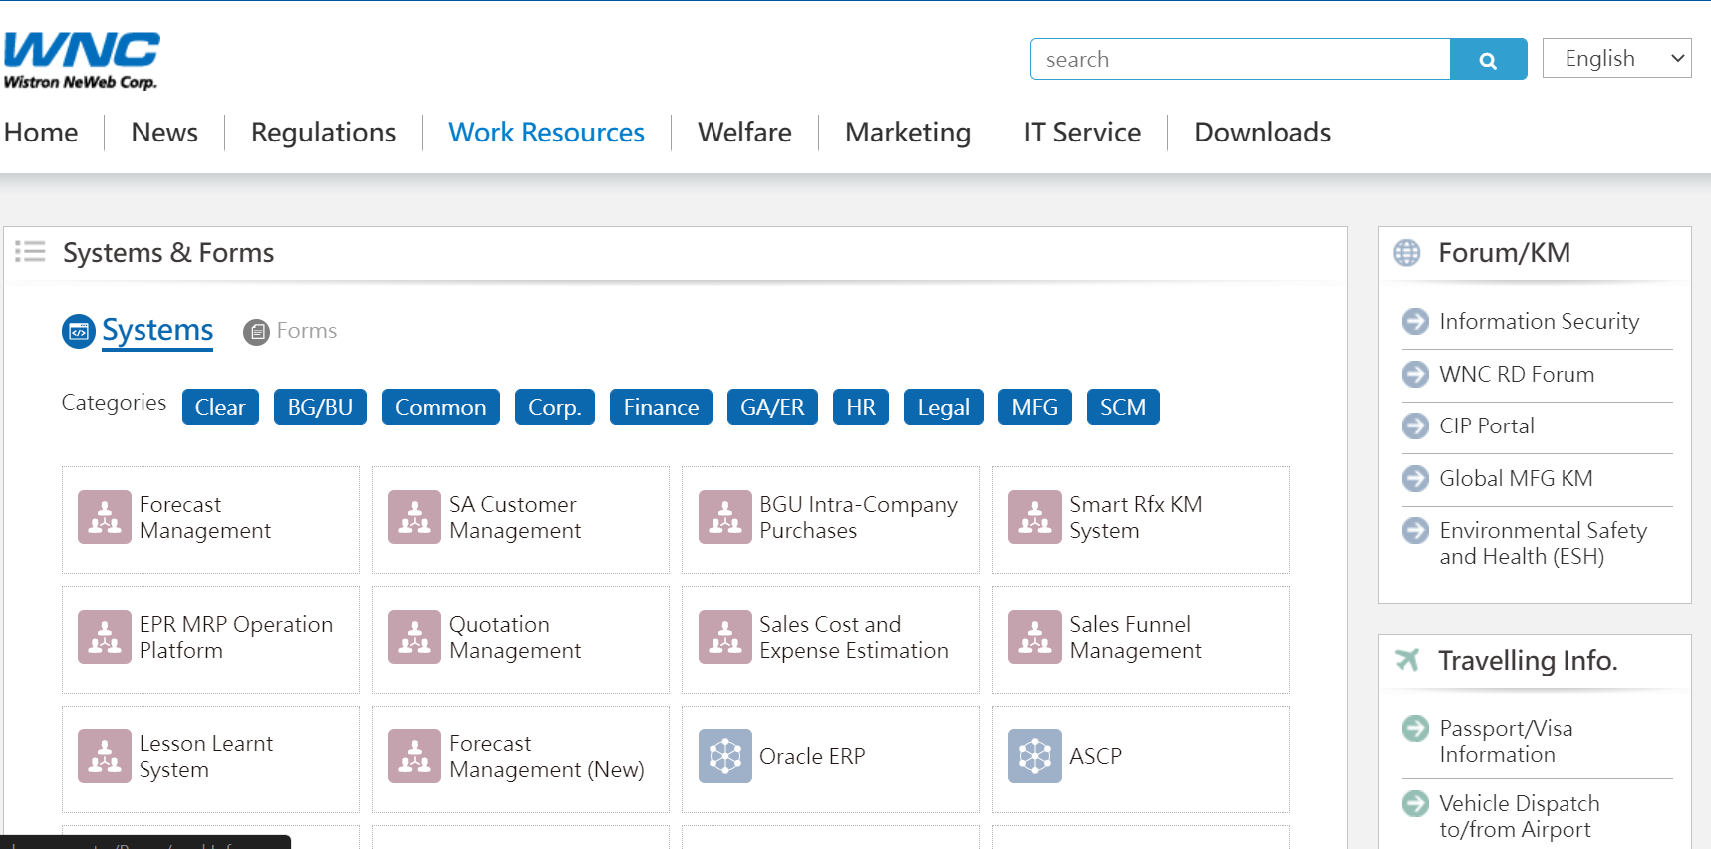
Dining Instructions & Food and Beverage Expense Details Inquiry
Daily subsidy of one Meal $25NTD
Employees are responsible for paying for the second meal.
Notes:
參考腳本
接著,吃的部份,公司是每日補助一餐.可提及公司工作生活平衡,制度設計解讀晚餐期待大家回家和家人聚餐.
平日/假日加班各有其規定,記得刷卡機要刷加班刷卡機.
當然,大家要查詢每日刷卡狀況可進portal查詢
* (0921新增)目前餐費補助原則 :以正餐設定為補助項目，主為提供同仁用餐時間在餐廳內正常用餐，目前不考慮增加其他項目(ex.水果攤、咖啡吧…等)補助。

Slide 27

Demo video
Notes:
參考腳本
接著,吃的部份,公司是每日補助一餐.可提及公司工作生活平衡,制度設計解讀晚餐期待大家回家和家人聚餐.
平日/假日加班各有其規定,記得刷卡機要刷加班刷卡機.
當然,大家要查詢每日刷卡狀況可進portal查詢
* (0921新增)目前餐費補助原則 :以正餐設定為補助項目，主為提供同仁用餐時間在餐廳內正常用餐，目前不考慮增加其他項目(ex.水果攤、咖啡吧…等)補助。

Slide 28

Massage Service
Each colleague is entitled to two times per month.

Slide 29
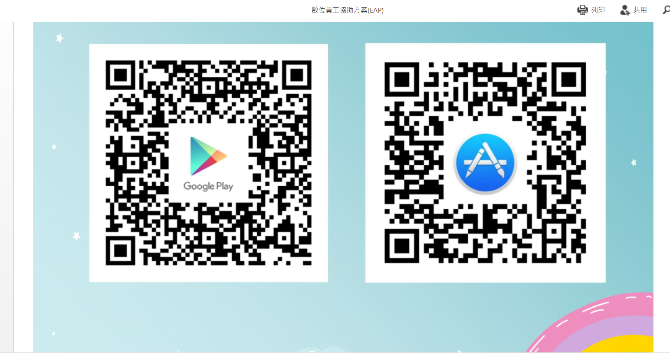
Mental Health
1.Download SpaQall app
2.Register with Email
3.Make Appointment
Online Service:
Monday to Friday, 9:00 AM to 7:00 PM
Mental Health
Legal Matters
Organizational Career Development
Insurance and Financial Planning
Health Education
數位員工協助方案(EAP).pdf (wnc.com.tw)

Slide 30
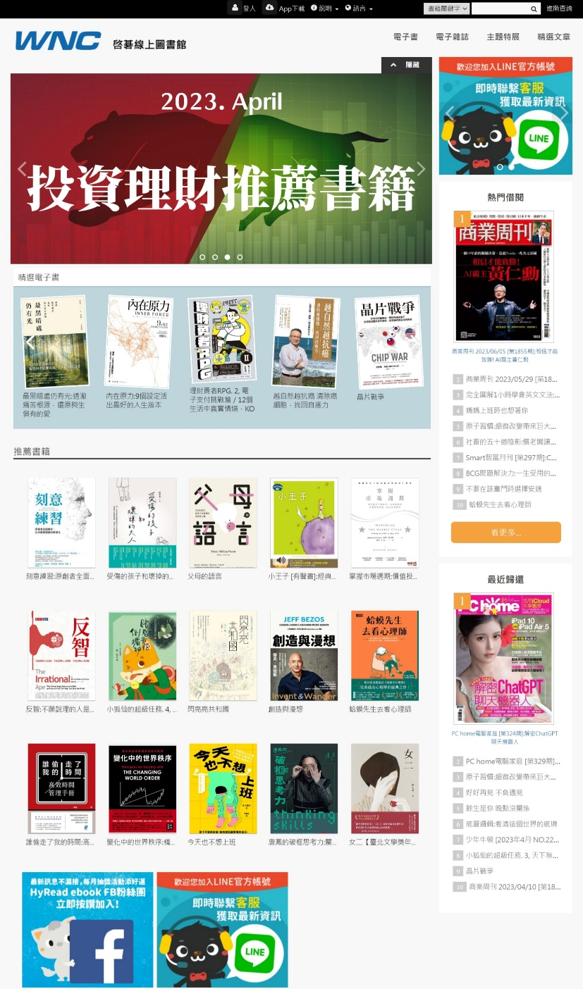

WNC Online Book Library

Slide 31

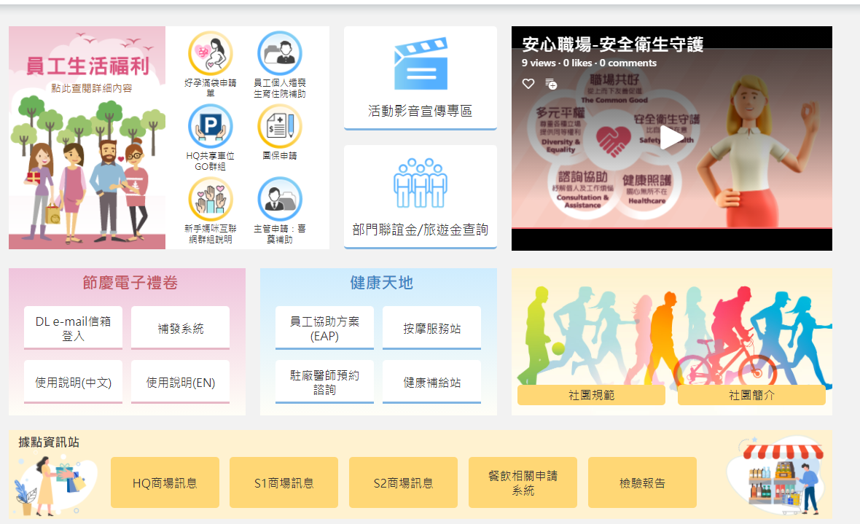
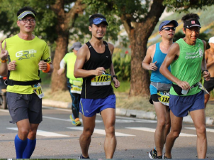

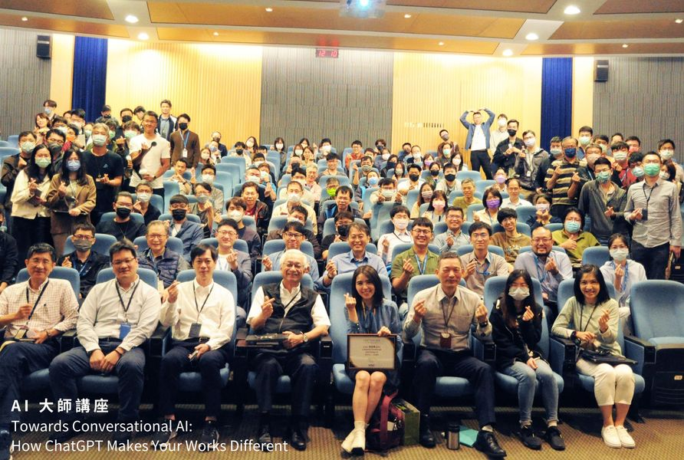
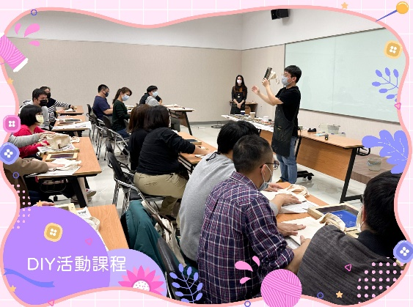
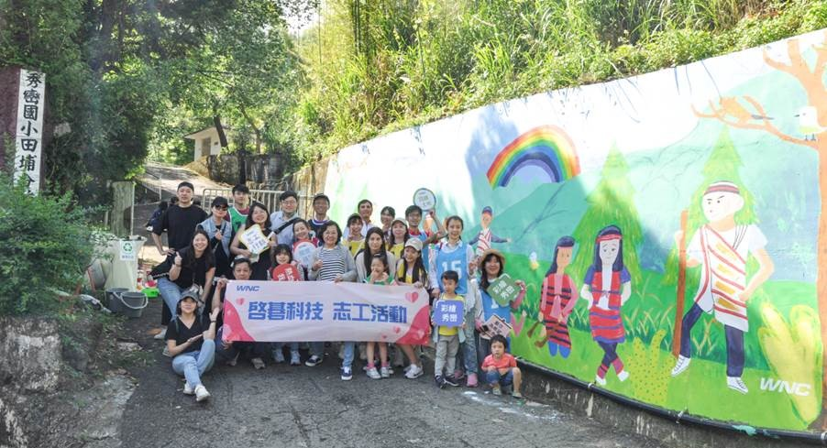
Join Social Club、Activities

Slide 32
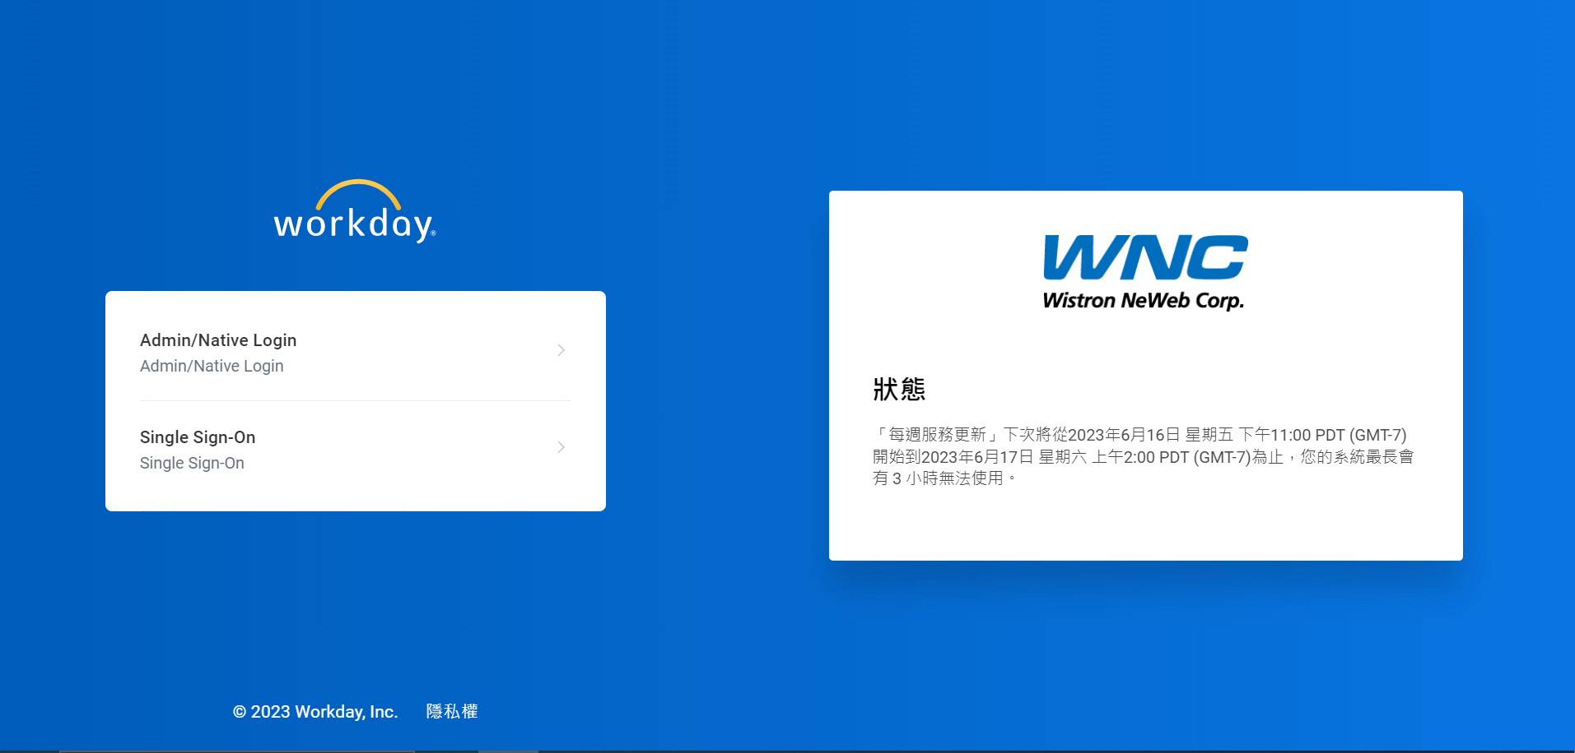
Workday
Build up your Personal Brand & Talent Profile

Slide 33
HR Division HQ_ (3F) S1_ (6F)
IT Service :(HQ:5F/S1:6F/S2:4F)
Useful Contact
Toolkit

Slide 34
HR Division (WTQ: 3F)
Name | Ext. | Service window (3F)
ZihAn Chen | 5543 | External Training or Off-site Training
Eddie Tu | 5450 | Digital Leadership Academy
Tobey Chiang | 5579 | English Proficiency Test Intelligent Manufacturing Academy
Thomas Chen | 5442 | Research and Development Academy
Fiyon Tai | 5551 | Employment Operations (including Manpower Budgeting and Planning, Internal Transfers and Secondments, Changes in Employment) Manpower Budgeting and Planning Internal Transfers and Secondments Changes in Employment Job Profile
Ginger Chung | 5414 | New Employee Orientation Program General Education Courses

Slide 35
HQ-HR(WTQ: 3F)
Name | Ext. | Service
Ivy Lo | 5510 | Promotion Management Talent Inventory Organizational Management CFT Cross-Functional Team
Rosalind Ding | 5574 | Performance Management Process Handling of Incompetent Personnel Probationary Evaluation Individual Development Plan (IDP) Management
Jessie YH Kuo | 5519 | Resignation Application Employment Verification Request Leave of Absence Application Probationary Evaluation Completion Assessment
ShihYun Chen | 5532 | New Employee boarding
Kelly Wen | 5506 | Salary Transfer
Wendia Chen | 5591 | Leave and Attendance System
Lisa Ko | 5546 | Employee Stock Trust
Sandie Liu | 5552 | Group Insurance Enrollment/Withdrawal Process Labor and Health Insurance Enrollment/Withdrawal Process New Labor Pension System/Reform of Labor Pension System

Slide 36
HQ-HR (WTQ: 3F)
Name | EXT. | Employee Relations/Service Window
Claire Chiang | 5518 | Labor-Management Conference、 Application for Maternity Gift、 Newcomers' Tea Party
Summer Han | 5429 | Welfare Committee (Welfare activity organization, application for wedding, funeral, and celebration, distribution of festival vouchers/gifts)
Mollie Chao | 5403 | Public Welfare and Arts & Culture-related
Karry Tseng | 5561 | Medical Examination Feedback Form, Injury/Illness Reporting/Care, Health Consultation, Infirmary & Lactation Room Management Factory Nurse Hotline: 5119
Miranda Chang | 5567
Name | EXT. | General Affairs/Service Window
Zick Yao | 5553 | Space and General Affairs Matters
Athena Li | 5556 | Access Control Application, Travel Request, Stationery Request, Parking Space Application
Sandy Jhu | 0 | Visitor Registration, ID Card Management, Business Card Production, Maintenance Request Management, Water Dispenser Management, DHL/FedEX/UPS Courier Fee Management
Shu Chuan Gong | 5537 | Green Mall Management
Austin Tsou | 5549 | Security Management, Office Automation Equipment, and Meeting Room Management
Carter Chen | 5534 | Cleaning Management, Photocopy Paper
*報修請利用提案平台。

Slide 37
S1 (S1:6F)
Name | EXT. | General Affairs/Service Window
Sharon Huang | 5315 | Visitor Entry, Emergency Maintenance Hotline, Transportation Management
CW Hsu | 5525 | Security Affairs Management
Gisele Ku | 5599 | Cleaning and Maintenance, Office Space Management
Cathy CC Chang | 5578 | Restaurant and Mall (Vending Machines, Water Dispensers) Management
Rex YK Lin | 5430 | Security Patrol Management, Factory Area Repairs
Name | EXT. | Employee Relations/Service Window
Linda Wu | 5566 | Medical Examination Feedback Form, Injury/Illness Reporting/Care, Health Consultation, Infirmary & Lactation Room Management Factory Nurse Hotline: 5119
May Wang | 5568

Slide 38
HR (S1 manufacturing site : 6F)
(name) | (ext.) | Service Window (6F)
Ray BR Chen | 5410 | DL Recruitment Strategy/Planning, IDL Recruitment Strategy/Planning
Yuhsuan Wu | 5565 | DL Recruitment Strategy/Planning
Dena Wang | 5589 | DL Trial Period, DL Rewards and Punishments Management, Sino-University Cooperation, Youth Employment Navigator Program
Jenny Lu | 5427 | Resignation/Leave of Absence/Retirement Application, Employment Certificate, DL Recruitment and Appointment (QA), Cooperative Education Management, Personnel Data Establishment and Maintenance
Vicky Chang | 5515 | Foreign Employee Management, Mingxin Foreign Student-Industry Cooperation, Graduation and Stay Application for Foreign Students
Valerie Tsai | 5261 | IDL Recruitment and Appointment, Foreign Student-Industry Management, Recruitment of Foreign

Slide 39
(S1 manufacturing site : 6F)
Name | Ext. | Service Window (6F)
Sherry Chu | 5445 | DL New Employee Onboarding, DL Attendance Management
Vincent Chen Debby Tseng Rita Liu | 5535 | Factory Training and Development Management
Chialin Kuo Jill Liu | 5572 5548 | S1 Factory Organizational Development Management
Fiona Yang | 5262 | DL Recruitment and Appointment (MFG), Dispatch Management, Audit
Alva Hsieh | 5431 | IDL Recruitment and Appointment, Talent Acquisition Management, Off-site Management
Penny Chou | 5573 | IDL Recruitment Administration, Recruitment Office Management, Onboarding Assistance

Slide 40
Digital Information Management Department (DMIS ) (HQ:5F/S1:6F/S2:4F)
Name | EXT. | Service
Ryan Lu | 5728 | AD Account, E-mail, File Server, Printer Device Management, Local Admin, USB Permissions
Emo Chen | 5734 | Internet Access Control
Ian Yang | 5636 | Network Administrator, Telephone System Administrator
Teddy Chen | 5624 | Network Phone Wiring Application, User Helpdesk Admin
Lib Huang | 5665 | OA Cloud, Anchor, File Decryption
Mia Wu | 5736 | OA Cloud, FTP, File Decryption
Alex Lin | 5628 | RD Cloud, Citrix, PC2, Git Lab, File Decryption
Angel Liu | 5656 | Computer Release Label Application
Michelle Han | 5632 | MVPN Application, Computer Equipment Inquiry, Webex Virtual Meeting Room Application
wncmis_helpdesk | HQ: 1118/1119 | Information System Related Issues, Telephone Extension Setup, New Employee Computer Distribution
 | S1: 1116/1117
 | S2: 1113/1114
有電腦的問題就儘管放馬過來吧!

Slide 41
Headquarters- Finance (WTQ: 10F)
Name | EXT | Service
Ariel Kang | 8805 | Overseas Travel Advance Cash Disbursement
Enpei Jen | 8817 | Reimbursement for Overseas Business Travel
Joy Chien | 8823 | Reimbursement for all Non-Sales Expenses
Paulina Liu | 8862 | Fixed Asset Reimbursement, Resignation Clearance Window
Notes:
2019/02/21 更新財務窗口

Slide 42


If you have More Questions Please ask Your Mentor First.
Tae Away

Slide 43
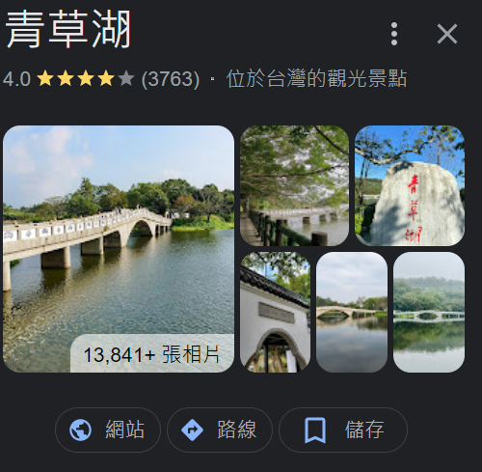
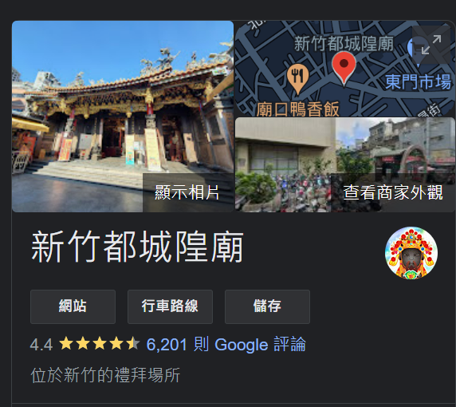

EAT & HAVING FUN TOGETHER
Hsinchu City God (Chenghuang) Temple
https://reurl.cc/QXnrLq
Green Grass Lake

Slide 44

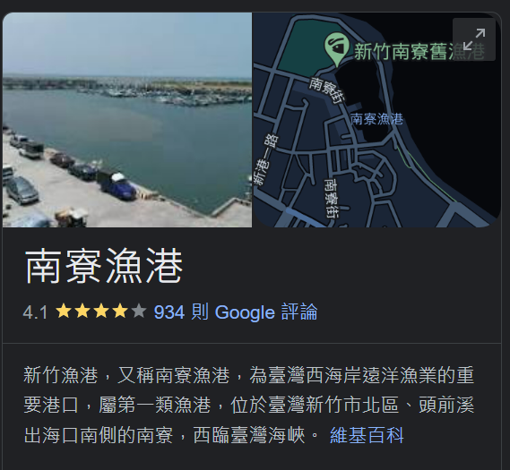

EAT & HAVING FUN TOGETHER
Hsinchu Nanliao Fishing Harbor

Slide 45
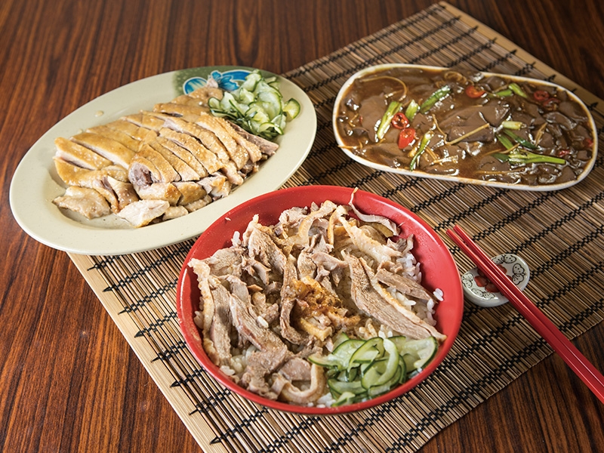
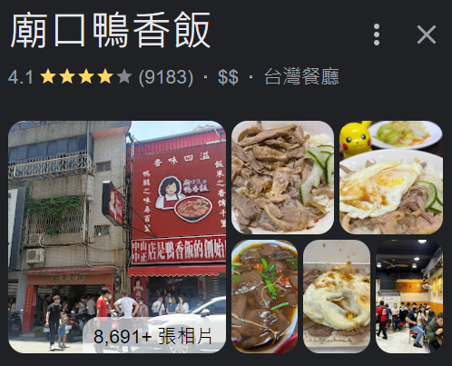
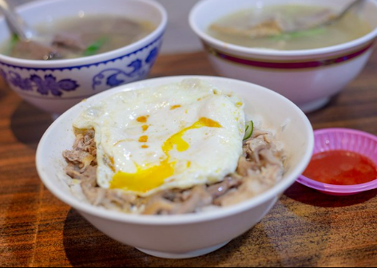
EAT & HAVING FUN TOGETHER
Duck Rice

Slide 46
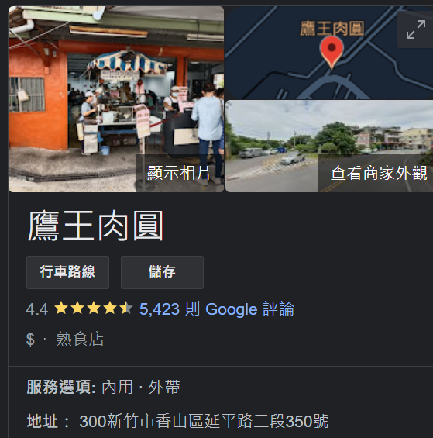
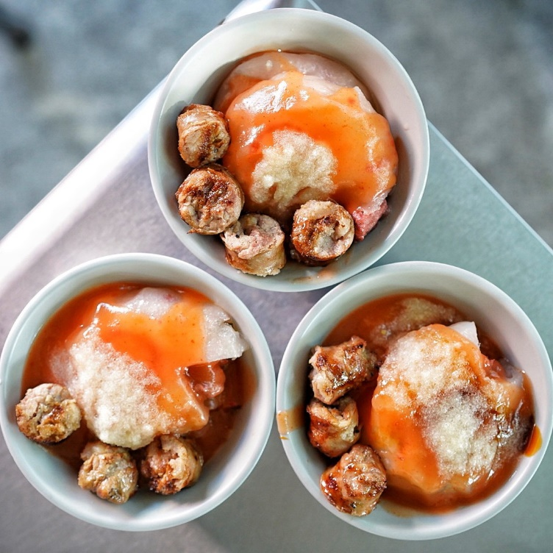
EAT & HAVING FUN TOGETHER
Meat Ball

Slide 47

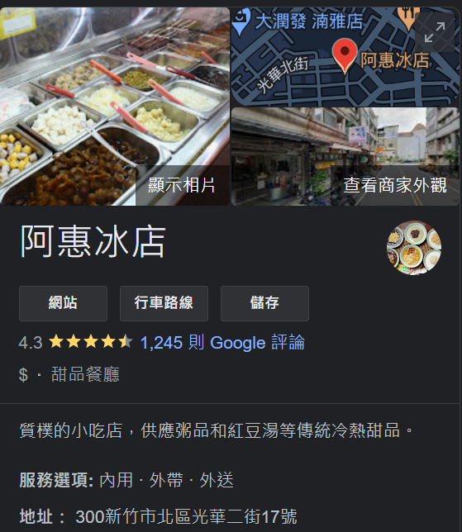

EAT & HAVING FUN TOGETHER
Shaved ice

Slide 48
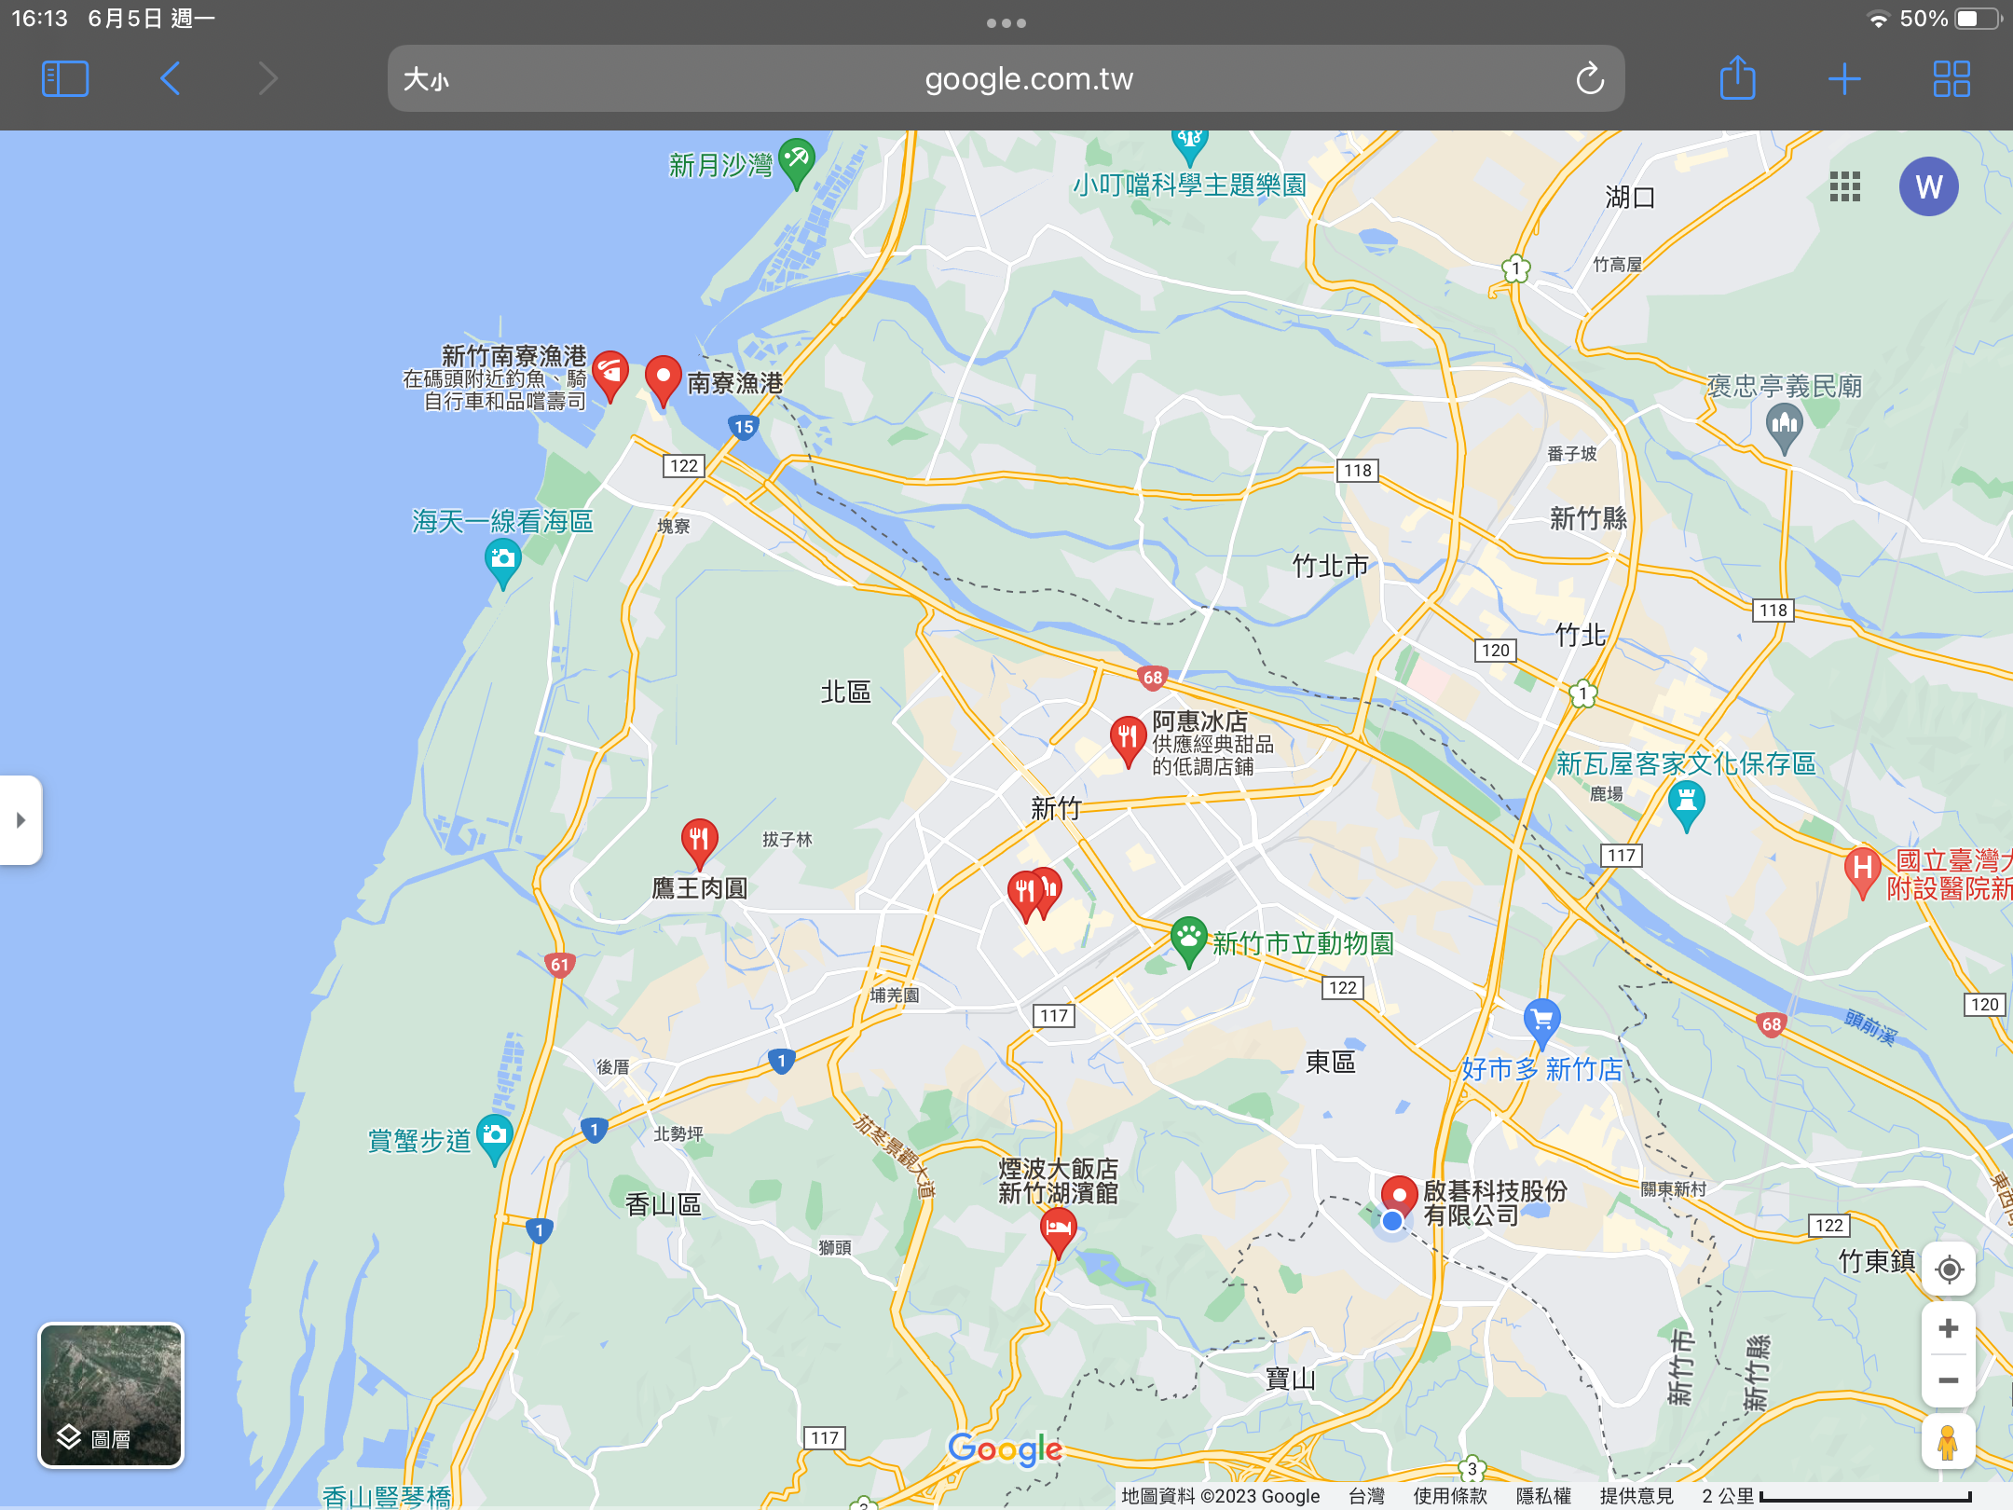

Slide 49


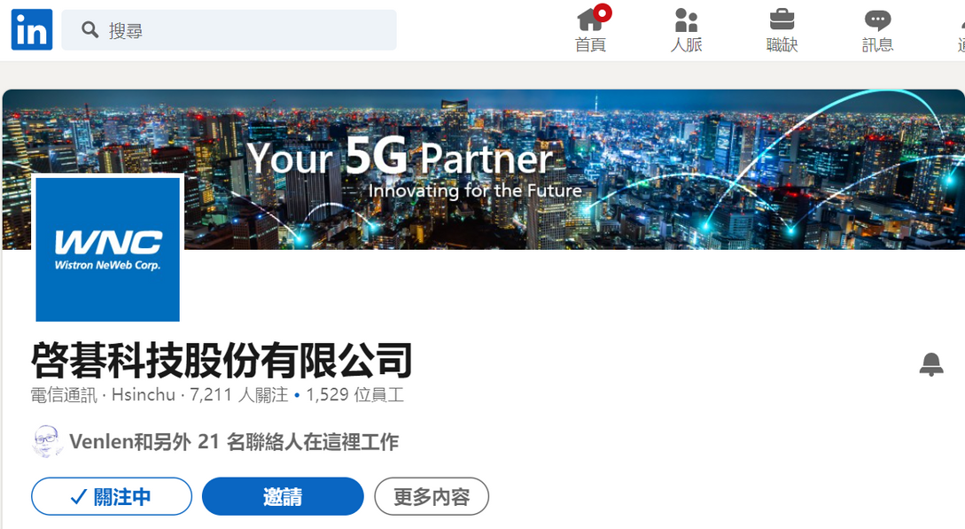
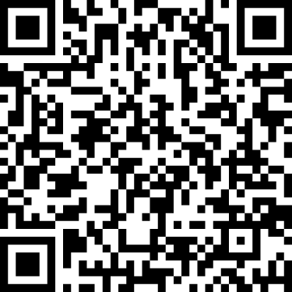

Welcome Aboard
ENJOY THE JOURNEY !

Slide 50
Intern Activities

Slide 51
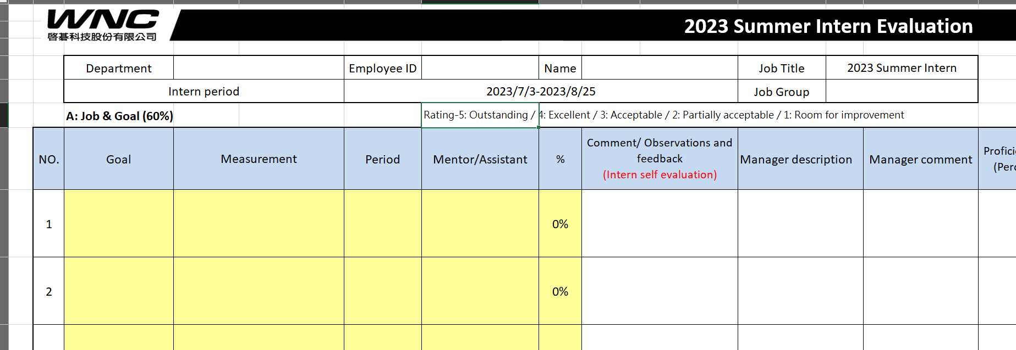
1. Self Evaluation (Required)
Remember to discuss with the manager！
Notes:
開始執行後可以跟各組的小隊輔HR討論，主題的部分

Slide 52
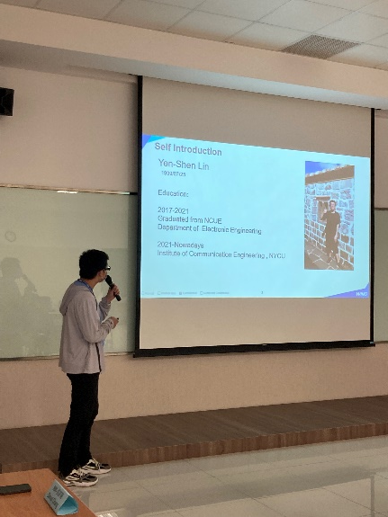
2. Project Presentation (Required)
On Aug 17 (Thu.) & Aug 18 (Fri.)
7 minutes project presentation
3 minutes Q&A
Try to present in English!
Presentation list will be announced on Aug 1st
Please send the PPT file to ShihYun.Chen@wnc.com.tw before Mon Aug 14th , 2023 12 p.m.
Notes:
開始執行後可以跟各組的小隊輔HR討論，主題的部分

Slide 53
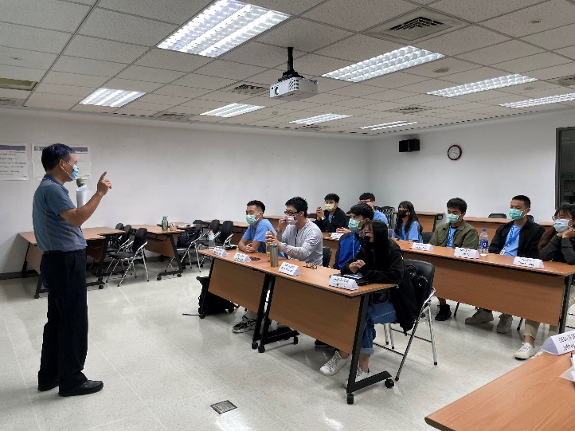
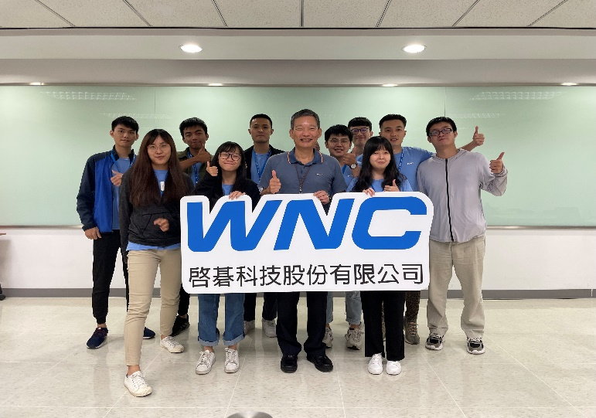
3. CEO Forum (Required)
On Aug 23th (Wed.) 13:30~14:30 p.m.
List the questions about what you want to know from Jeff.
Introduce who you are / share your life in WNC. (by group)
Team leader please send the PPT file to ShihYun.Chen@wnc.com.tw before Mon Aug 21th, 2023 12 p.m.
Notes:
開始執行後可以跟各組的小隊輔HR討論，主題的部分

Slide 54

4. WNC Reporter-Facebook Post (Optional)
Topic: Job content, WNC environment, company culture, internship activities, clubs …
Post must include:
1. Topic
2. Content
3. Reporters
4. Photos
Try to work with other students from different countries.
Participants will get a reward.
Notes:
開始執行後可以跟各組的小隊輔HR討論，主題的部分

Slide 55
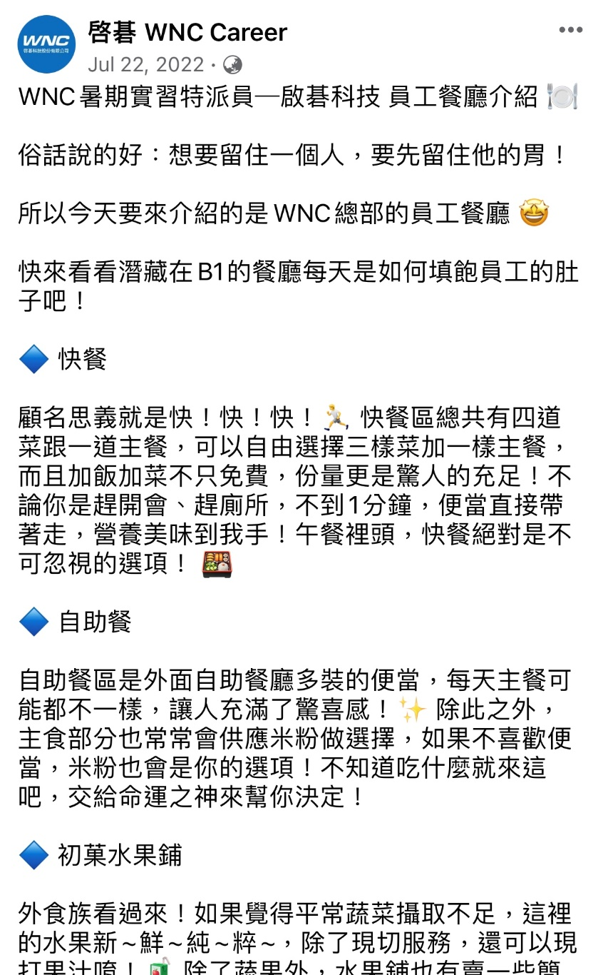
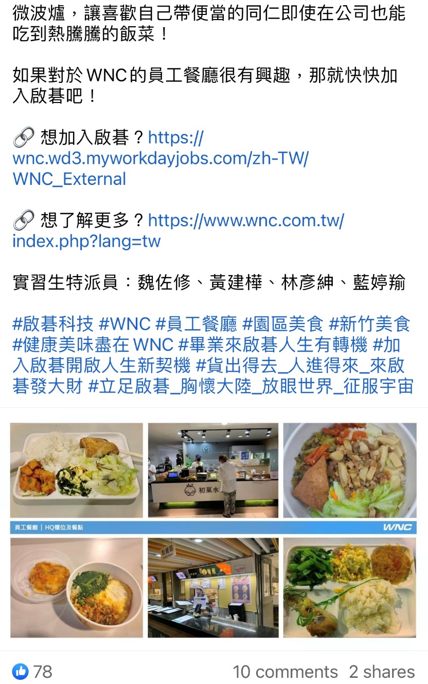
Example
1. Title
2. Content
3. Reporters
4. Photos

Slide 56


5. 1-on-1 Online Session (Optional)
Feel anxious about the future.
Question about academic & career.
Want to know information about the tech industry?
Multiple career experts from diverse backgrounds.
Share self-experience and perspective.
Provide professional advice individually.
Notes:
開始執行後可以跟各組的小隊輔HR討論，主題的部分

Slide 57
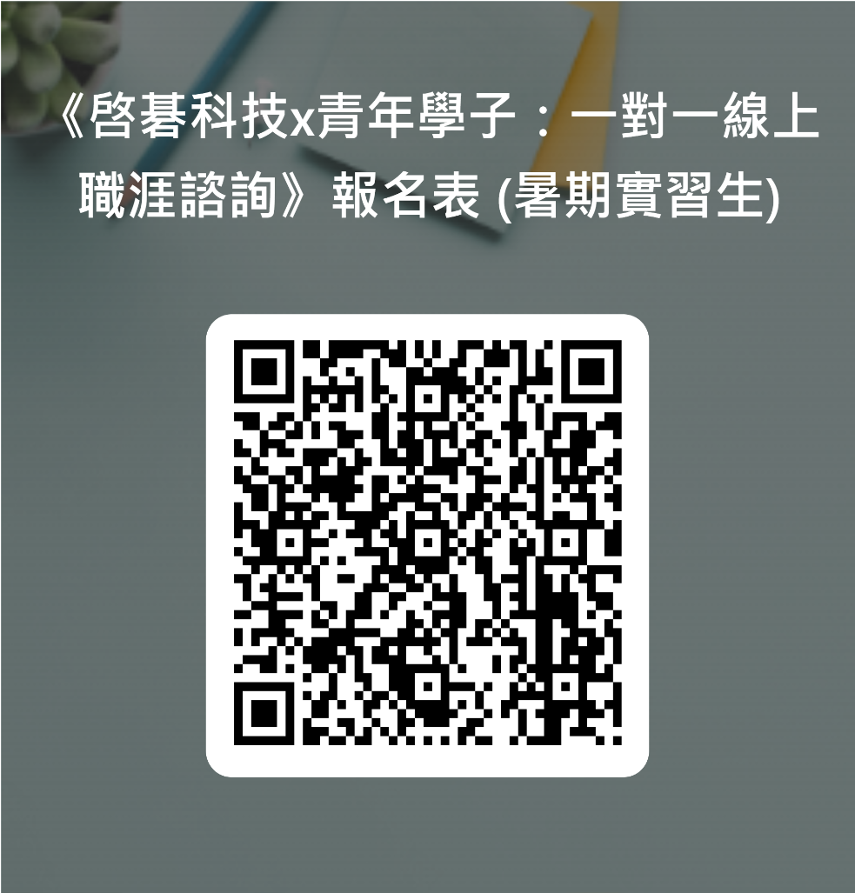

Feel free to ask for further information :
PIC: Rita Lo #5582 Rita.Lo@wnc.com.tw

Slide 58
Calendar (July)
Mon | Tue | Wed | Thu | Fri
7/3 | 7/4 | 7/5 | 7/6 | 7/7
On Board Date | Orientation
7/10 | 7/11 | 7/12 | 7/13 | 7/14
 |  |  |  | Questionnaire
7/17 | 7/18 | 7/19 | 7/20 | 7/21
7/24 | 7/25 | 7/26 | 7/27 | 7/28

Slide 59
Calendar (August)
Mon | Tue | Wed | Thu | Fri
7/31 | 8/1 | 8/2 | 8/3 | 8/4
8/7 | 8/8 | 8/9 | 8/10 | 8/11
8/14 | 8/15 | 8/16 | 8/17 | 8/18
Deadline to submit presentation file / Self Evaluation (8/14-18) |  |  | Presentation | Presentation
8/21 | 8/22 | 8/23 | 8/24 | 8/25
Deadline to submit “Life in WNC” file (Group) |  | CEO Forum |  | Last day in WNC

Slide 60
2023 Internship Program
Project presentation
One on one session
LMS learning system
Learning
Feedback
Teamwork
WNC Reporter
CEO Forum
Questionnaire
Notes:
暑期實習主要幫助大家三個面向的建立，
在最後會有一個實習成果發表，讓各位兩個月來的努力最後有個展現、另外我們有安排職涯座談，會邀請公司的同仁(資深、入職不久的同仁)跟大家分享職涯的酸甜苦辣、另外大家可以多加利用我們的LMS教育訓練平台，可以去選擇想聆聽的課程學習
適應關懷的部份我們有安排一系列的問券，像是關懷問卷、課程問卷等等，
如果一些困難，不好跟其他實習生/輔導員或者HR分享，或有建議回饋等等，非常鼓勵透由這樣的管道提供給我們唷
實習的最後我們有個重頭戲，將安排公司的執行長Jeff來跟大家座談唷! 這是一個很好的機會， 各位可以想想有沒有想問或者想對Jeff說的話，我們後面會再邀請大家提供

Slide 61
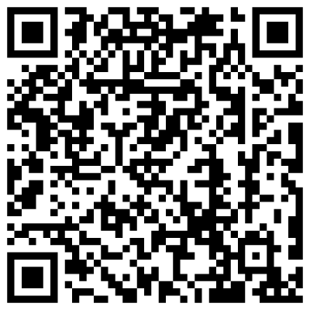
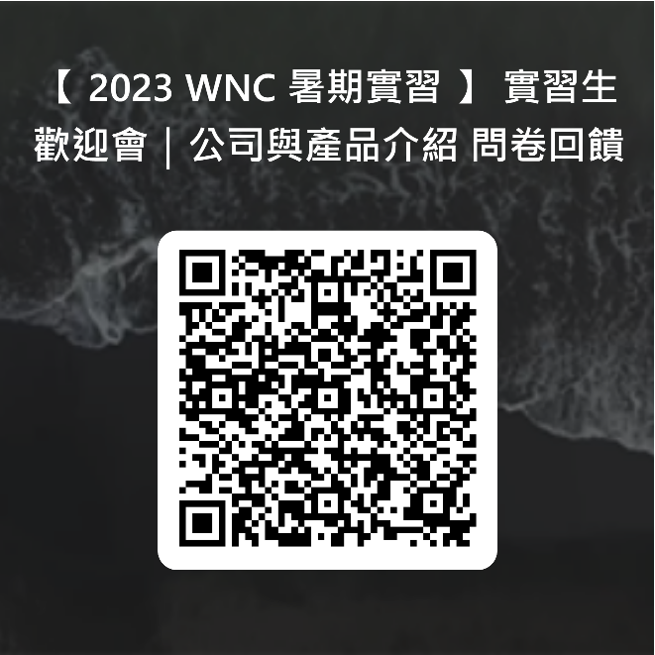

WNC Career FB
Questionnaire

Slide 62
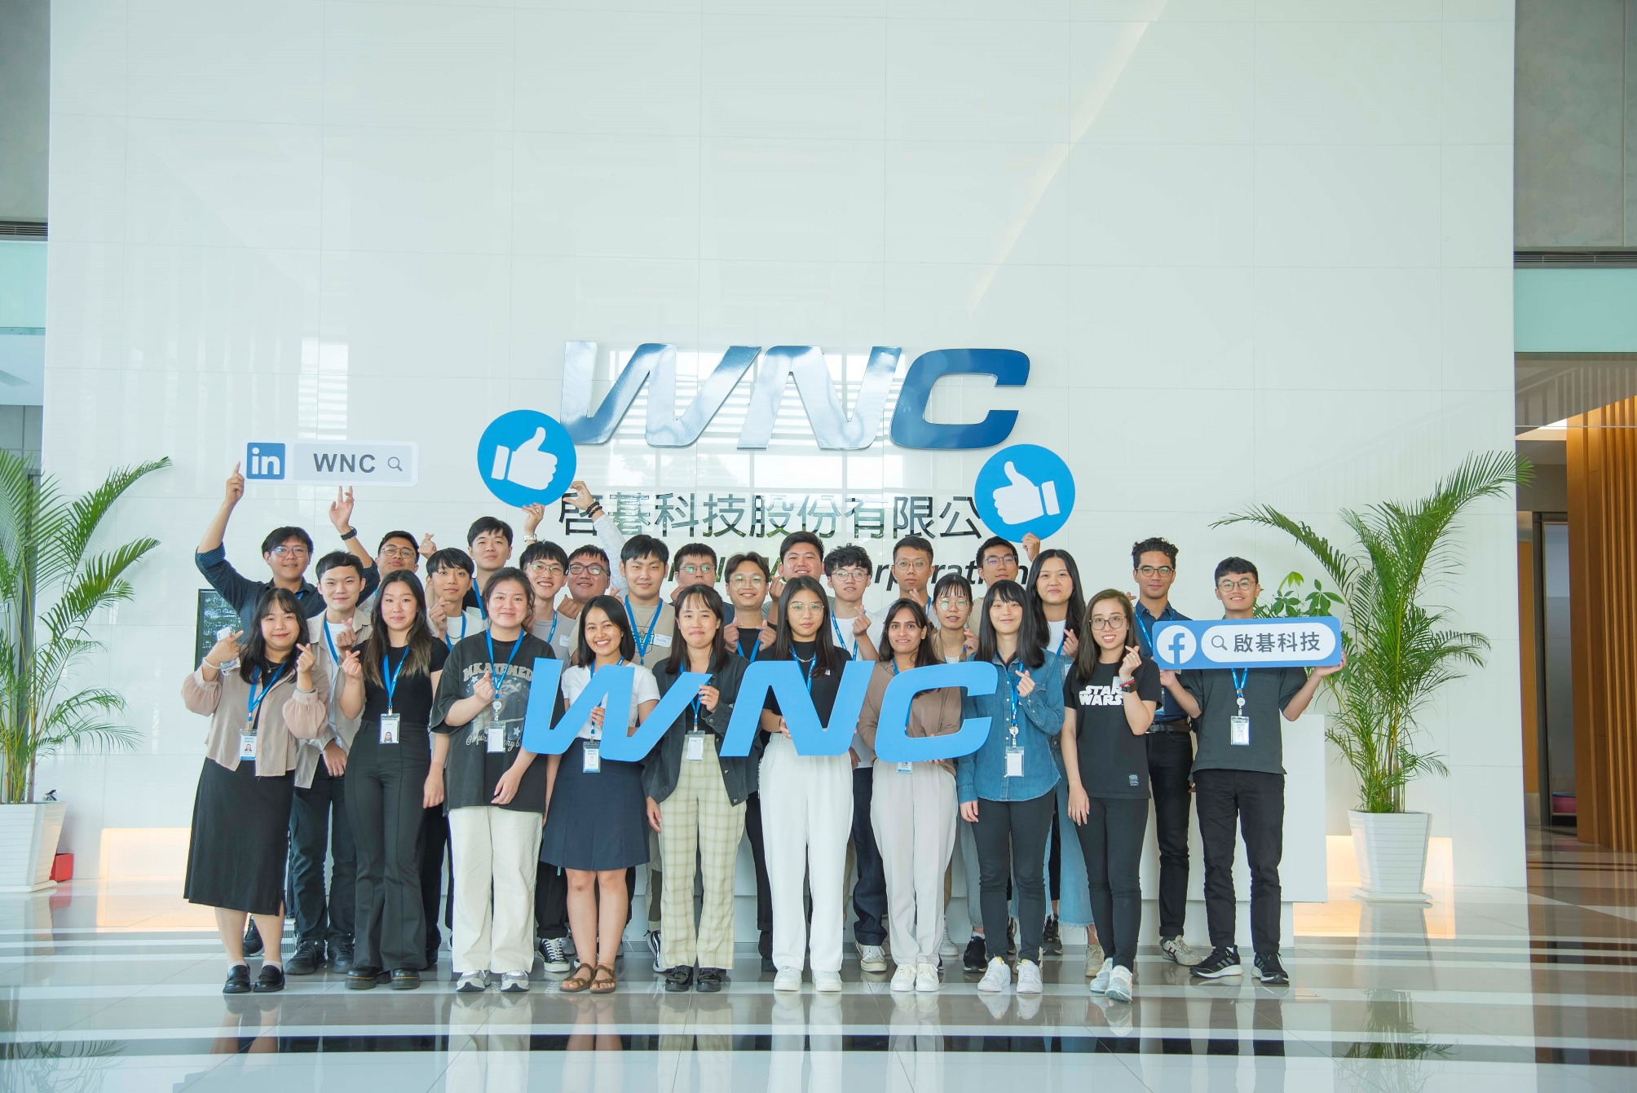
Welcome!!!

